Slide 1







A
Complete Vehicle Tracking Solution
iOS App
Android App
Camera
Fuel Monitoring
SOS

Slide 2
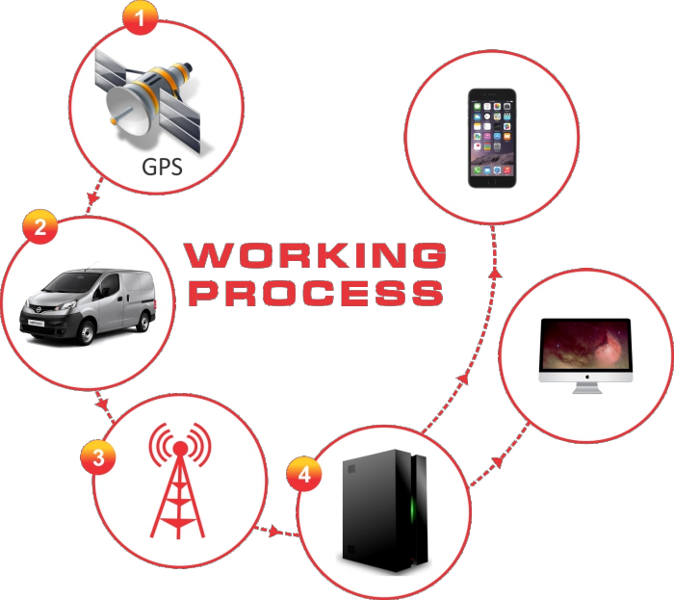
Company Profile
KST a One Stop Shop for every Vehicle
Tracking Genie is a product of K S Technosoft Pvt Ltd, which is part of KS Group of companies. KS Group is the largest automobile dealers' network in India.
Tracking Solution
Tracking Genie is an innovative and cost effective world-class provider of Vehicle Tracking and Asset Tracking Solutions. We are an ISO 9001:2008 certified company. We provide robust hardware along with a cutting edge web and mobile application to help our customers manage their fleet of vehicles. Along with well defined processes in place to support and provide world class devices and software solution we also have a very well refined yet flexible model for design, development, deployment and maintenance of customized vehicle tracking solutions based on our customers' needs.
Our passion is helping business houses find new ways to grow, to get more done every day, and to delight their customers with better service. With our innovative vehicle tracking and asset tracking solutions, you can have a more complete picture of what happens in the field and use that knowledge to improve business. We transform the complex and ever growing mounds of data and paper ,your business creates every day into simple, easy-to-understand information so you have the knowledge and confidence to make the right decision.
w w w . t r a c k i n g g e n i e . c o m

Slide 3
We Serve
Real Time Tracking
Fleet Status Dashboard
Alerts and Notifications
(SMS/Email)
Remote Vehicle
Shut down/Start
Tracking History
Remote Digital
Data Management
Replay Tracking
Reporting
Vehicle Maintenance
Fuel Monitoring
Administration
Messaging
Tracking Genie helps improve Mileage, Vehicle Running Cost, Employee performance
Which helps in increasing Productivity and Efficiency
w w w . t r a c k i n g g e n i e . c o m

Slide 4

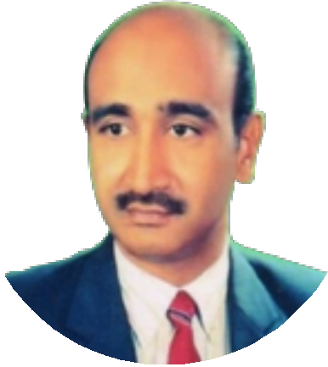
Message
from
Chairman
K S Technosoft Pvt. Ltd. has grown from small beginnings into a leading provider of tracking devices. KST has successfully
pursued an expansion strategy both in terms of developing innovative solutions and diversifying its client base across
several countries and industries.
KST has always strived to be ahead of the curve by anticipating the market needs and will continue to do so by working
closely with clients as well as technology partners.
Kishore Singh Gehlot
w w w . t r a c k i n g g e n i e . c o m

Slide 5
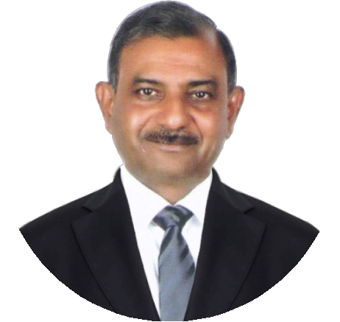
Message
from
CEO
Good may be good enough for some. But most of us want more than that. There is something inside us that tend to
make us want to be better than good. We build to be part of a team whose members are family, and even years later, will
be remembered for what they achieved!
Under our aim to establish company for sustainable growth based on the philosophy of placing our clients at
the heart of everything we do.
Deepak Singh Gehlot
w w w . t r a c k i n g g e n i e . c o m

Slide 6
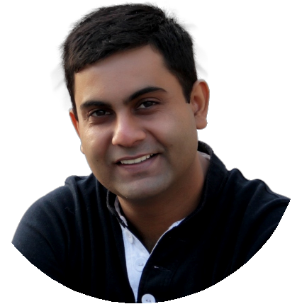
Message
from
Head
International
Operations
As a Head International Operations of K.S.Technosoft Pvt. Ltd., one of my responsibilities is to acertain that we have the
right people, processes and technology to deliver.
We believe in transparency of our collective processes .With flexible engagement we work with our clients as an extension of our IT services team, helping you leverage the most of your IT investment.
We lead with our IT strength and know-how, with Management of over many years in the IT space. We happen to be a
Company, offering you the benefits of dissimilarity and acquisition with our years of IT management and leadership
experience. Our commitment to quality stands on its own. Put us to the test, and see why engaging us for all your IT services
needs brings your bottom line A World of Difference.
Aproov Gehlot
w w w . t r a c k i n g g e n i e . c o m

Slide 7
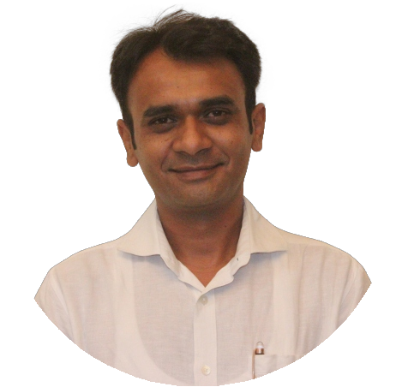
Message
from
COO
Welcome aboard our team ! As a company, we have seen much change over the past many years.
True corporate responsibility imposes far more than giving back. It's our dedication to provide products and services of the
highest quality. It's our drive responsibility that we tend to develop new platforms and applications that give people greater
and complete control over their livelihood. Everything we deliver, upgrade and invent not just to customers, but to all of our
employees: We're here to help.
Looking ahead, we are focused on accelerating the execution of our growth strategy while continuing to build on the
strength of our branding helping our clients share knowledge and create innovation and in bringing positive change to the
communities in which we work and live. I am incredibly excited about this journey and truly believe the best ofeverything is
yet to come.
Puneet Rao
w w w . t r a c k i n g g e n i e . c o m

Slide 8
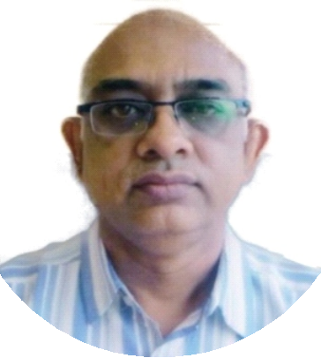
Message
from
Director
For me the most important aspect of business is the company culture which comes from its management and employees. At
K S Technosoft Pvt. Ltd., its employees can visit any of its various departments or its customers can interact with its employees and recognize its culture.
Important values of our culture that drive everything we do are Integrity, Innovation, Engagement and Care. All our
employees are empowered to ask questions, make recommendations and continuously change things for the better. Leaders
are role models, and rewards are given for outstanding performance.
KST is made up of talented individuals with a common identity.
We plan to achieve this goal through our strength - the Employees; and seek their continuous involvement in achieving the
Company's objectives. I therefore, seek continued patronage of our valued customers, cooperation of our employees and
thank our well-wishers who have contributed to the growth of the organization.
Rajiv Sharma
w w w . t r a c k i n g g e n i e . c o m

Slide 9
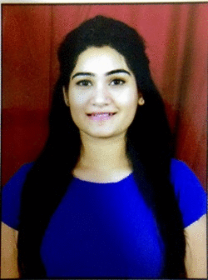
Message
from
HR
Our mantra is to provide best quality services in order to ensure improvement in productivity through a proper
Management of HR, Admin, IT, logistics operations.
At K.STechnosoft, we're dedicated to get into a trending culture in which our employees feel challenged and appreciated
and have the opportunity to demonstrate their skills and abilities. We also emphasize professionalism and responsibility to
be incorporated in the work culture.
We have several opportunities with qualified people, to manage any one of our branches. We are developing a training
policy which promotes opportunities for advancement and betterment of the company production and also the employee
skills in our company. Our future employees are encouraged to adopt our strong and ethical values, which are: tolerance, equity, commitment, teamwork and expertise.
Nisha Saini
w w w . t r a c k i n g g e n i e . c o m

Slide 10
Vision Mission & Objective
Vision Mission
Empowering People
Our mantra is to provide best in class services to the customers and therefore enabling the success of our clients alongside with
creating an environment of passion , honesty and courtesy towards our clients, employees and society at large.
Objective
Understanding
the Needs
Work with
Speed and Time
Find the Customer
requirement and
Problems
Execution based
on core Values & Mission
Efficient
Working with
Quality
w w w . t r a c k i n g g e n i e . c o m

Slide 11


















Our
Clients
w w w . t r a c k i n g g e n i e . c o m

Slide 12



KST Panel
We
Consider
Your trust as
The crux of KST's panel includes qualified and experienced management along with the proficient team
of Customer Care, Sales/Marketing, Designers, Developers.
We make it a point to be an expert in all the latest technologies of web and mobile. Also make sure that
all our employees get out of the box training and become
expert of their genre.
Experience
No. of Employees
10+ Years of Experience
02
5+ Years of Experience
03
3+ Years of Experience
04
2 – 3 Years of Experience
09
1 – 2 Years of Experience
16
New Graduates
06
Total
40
Note: Figures last revised on date 17-12-2016
w w w . t r a c k i n g g e n i e . c o m

Slide 13








Organization
Hierarchy/Structure
CEO
Deepak Singh Gehlot
HIO
Apoorv Gehlot
COO
Puneet Rao
Director
Rajeev Sharma
Renewal
Supervisor
Accounts / Operations Associate
Sales
Supervisor
HR
Customer
Manager
Care
Renewal Executive/ Coordinator
Renewal
Associate
Sales
Associate
Front Desk
Operator
_{Team} ^{Cust}
_{Leader}
Supe
Leader
omer
rvisor
Care
House
Keeping
Customer Care Associates
Care
Executives
w w w . t r a c k i n g g e n i e . c o m

Slide 14

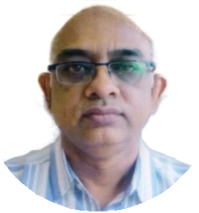


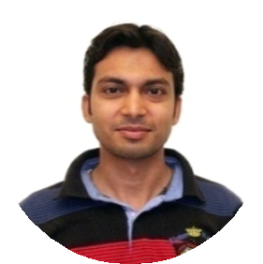
Head
of
Department
Deepak Singh Gehlot
Chief Executive Officer
Rajeev Sharma
Director
Apoorv Singh Gehlot
Head International Operations
Puneet Rao
Chief Operating Officer
Manish Soni
Technical Head
Nisha Saini
Assistant-HR
w w w . t r a c k i n g g e n i e . c o m

Slide 15
Recruitment & Selection Procedure
All employment opportunities at K S Technosoft Pvt. Ltd. are posted for a minimum 10 working day period. They are posted on K S Technosoft Pvt. Ltd.'s website and on the websites of affiliated organizations. Occasionally, they are posted on employment websites or with an employment agency. Applications are encouraged from current employees but will be screened in the same manner as applications received from outside applicants.
Applicants are invited to submit their application, along with a current resume, demonstrating that they meet the minimum criteria for the position being sought. At the closing date, all applications are screened, and candidates selected for interview are contacted. If the interview is positive, references will be contacted. Depending on the feedback provided, a position may be offered to the applicant.
Recruitment of candidates is the function preceding the selection which helps create pool of prospective employees for the organization so that the management can select the right candidate for the right job from this pool. The main objective of the process is to expedite the selection process.
Resources:
There are various resource for recruitment through which KST gets well qualified candidates for the profile. There are two types of resources:
(a) Internal Resources:
From Existing Employees
(b) External Resources:
Company Website
Recruitment Consultants
Job Portals (i.e. Naukri.com, Monster, Times Job, etc)
Newspaper Ads
Ratio: Out of Approx 20 interviews only one candidate goes to second round and out of 30 interviews only one candidate is selected.
w w w . t r a c k i n g g e n i e . c o m

Slide 16
Recruitment & Selection Procedure
Appointment
The candidates who have successfully gone through all the recruitments steps, HR department initially issue an offer mail to selected candidates duly approved by the Director. Before employment can begin, new employees must submit all required documents or certificate to the Department of Human Resources. Failure to comply with this policy will lead to suspension or discharge.
All new employees are required to serve a probationary period as per the policy given under Salary Policy section.
After Selection
Training Period : One month training period. After one month of training the TeamLeaders would assess the trainee on the set criterias and thereafter further decision would be taken. It can be :
Probation Period
Extended Training Period
Termination
Probation Period : The probation period would be for next Three months. During this period the Department Head would train the team member according to KST protocols. There would be NO leave granted during training or probation period. The leaves taken would be deducted from the salary.
After probation period the Department Head & HR Manager would submit the assessment/Review report to Manager. Based on which the decision would be taken-
Confirmation
Termination
Revision of Salary
There would be NO leave granted during Training and probation period. The leaves taken would be deducted from the salary.
There would be change in salary after confirmation.
Allotment of Designation
w w w . t r a c k i n g g e n i e . c o m

Slide 17




Recruitment & Selection Procedure
Personal Files
These documents need to be submitted within one week of joining:
10th Mark Sheet
12th Mark Sheet
Graduation Mark Sheet
Post Graduation Mark Sheet
Any other education certificate
2 Identity Proofs (Voter ID, Ration Card, Driving License, Passport etc)
Experience Certificate
Resignation Letter (from previous company)
Proof of Salary (Salary Slip or Bank Statement)
w w w . t r a c k i n g g e n i e . c o m

Slide 18
Salary, Evaluation & Welfare
Salary Administration
Pay-checks are distributed on the 7th of each month, and eligible employees are benefitted with ESI and PF facilities.
The increments are moderately done every financial year (April) based on performance.
Performance Assessments
We do performance assessments of all members
After Training
After Probation
Every Month by Department Head
Periodic Department Wise and Project Wise Evaluation
Yearly Assessment is done every Year in March
Awards for Best Achiever, Punctuality, Congeniality, Discipline and best Initiative(if taken) is given every month.
Grievance and Disciplinary Policy
All KST Members can send their private or public suggestion/complaint to the Supervisor/Department Head and then the complaint/issue is to be sent to HR Manager and he should deal the issue keeping the Director in the loop.
Employee Welfare
Statutory
Tea/Coffee at all the time
First aid facilities
Regular incentives
Maternity leaves
Non-Statutory (Voluntary)
Monthly Recreation Activities
Diwali Bonus
Party (High tea or Lunch) on various festivals
Performance Award
w w w . t r a c k i n g g e n i e . c o m

Slide 19
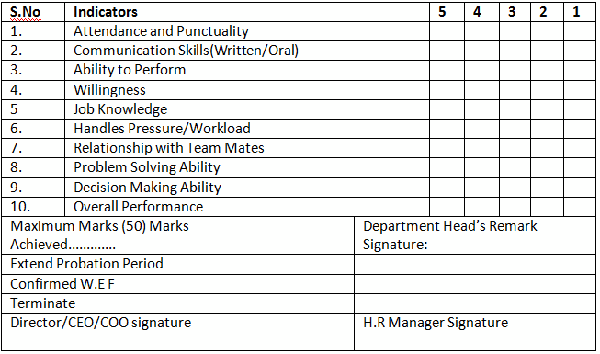
Training
Period
Assessment
w w w . t r a c k i n g g e n i e . c o m

Slide 20
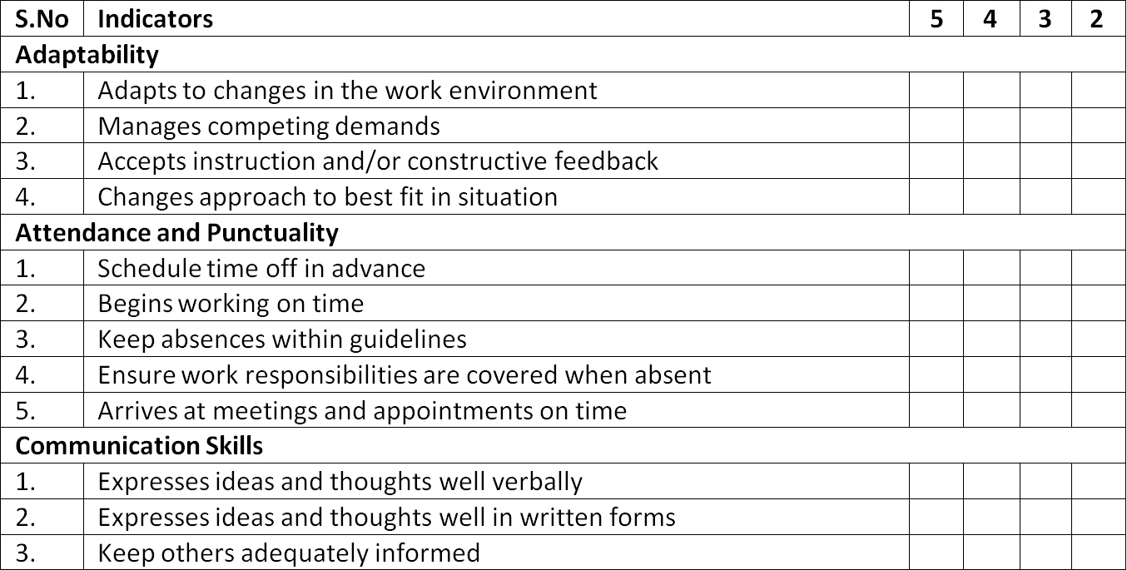
Monthly
Assessment
w w w . t r a c k i n g g e n i e . c o m

Slide 21
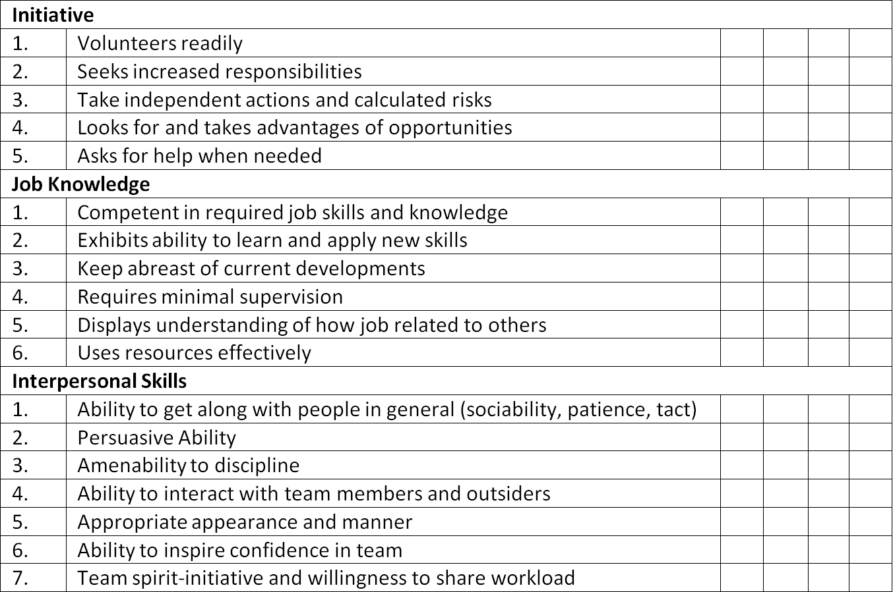
Monthly
Assessment
w w w . t r a c k i n g g e n i e . c o m

Slide 22
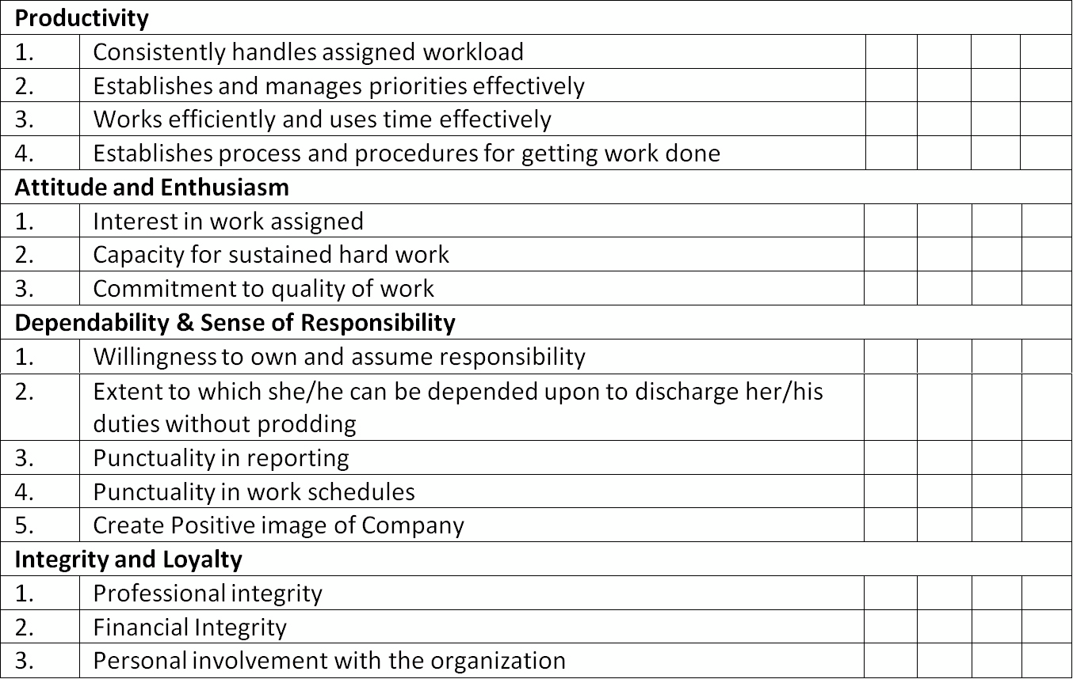
Monthly
Assessment
w w w . t r a c k i n g g e n i e . c o m

Slide 23
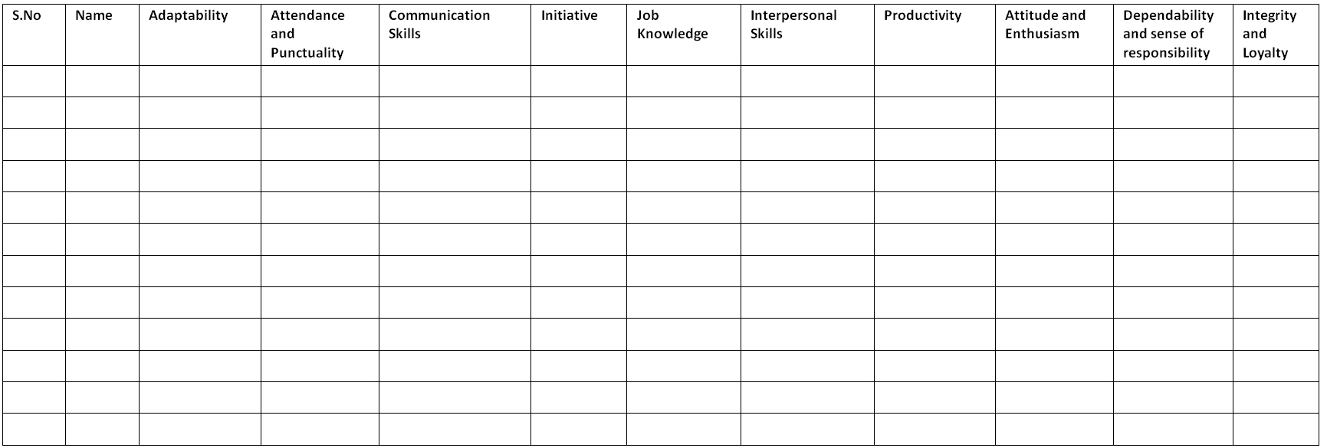
Assessment
Criteria
w w w . t r a c k i n g g e n i e . c o m

Slide 24
Committees
Quality Assurance
Committee
Puneet Rao,
Rajiv Sharma
Staff Selection
Committee
Ritu Upadhyaya, Nisha Saini
Performance Appraisal
Committee
Rajiv Sharma, Dept.Head,
Nisha Saini
Anti Sexual Harassment
Committee
Ritu Upadhyaya,
Niket Sogani
Grievance Redress
Committee
Rajiv Sharma,
Nisha Saini
Training
Committee
Ritu Upadhyaya, Nisha Saini
w w w . t r a c k i n g g e n i e . c o m

Slide 25
Working Environment
KST is an Equal Opportunity Employer. We offer a competitive salary, outstanding benefits and the professional advantages of an environment that supports our employees development and recognizes their achievements.
Operating with Integrity
KST seeks to lead in workplace and marketplace integrity by respecting the human rights of everyone touched by our business.
Work and Life Balance
KST encourages our people to meet their work commitments while balancing their own life responsibilities. To support this balance, flexible work arrangements are an integral part of the way we conduct business.
Accept the
right position
Take
Responsability
POSITIVE
WORK ENVIRONMENT
Be social
Be positive
Communicate
w w w . t r a c k i n g g e n i e . c o m

Slide 26

Benefits for extended work hours
An employee would be eligible for one compensatory off against the working on public holiday. This off would lapse in two months.
To avail compensatory off, employee has to work at least five hours on holidays.
Compensatory off would be sanctioned only if the employee has worked on Projects, device installations not for trainings or to finish his/her pending work.
Not more than 2 days compensatory off can be availed at a time.
While on compensatory off, weekly off and paid Holidays will be excluded for computation.
Compensatory off would be completely on Line Manager’s and Management’s Discretion.
Rules to comply
KST strongly discourage going out of office unless it’s an emergency or extremely important task.
Employee can go out during office hours for maximum one hour.
This provision can be availed not more than twice in a month.
If an employee does not report back in one hour it will be marked as half day.
Employee need to fill the Gate Pass and get it signed by the Line Manager before going out of office premises for any personal work/emergency.
Basic HR Policy
WORK HOUR POLICY
Working Hours Office Time Lunch Time
:
:
:
9 Hours a Day
09:30 am to 06:30 pm
Half an Hour (Anytime between 01:00 pm to 02:00 pm)

Slide 27
LOSS OF PAY (LOP):
LOP is applied when leave information do not reach on time, leave is not taken in advance with proper approval, when one does not have leave balance available etc.
An employee in notice period is not entitled for any leave, if in case they take any leave it will come under LOP.
If an employee fail to report to office without any prior information , it will be marked as LOP.
LEAVE POLICY
LEAVE YEAR AND APPLICABILITY:
Leave year is from 1st January to 31st December.
Employees who are appointed during the course of the year shall be entitled to the above leave on pro-rata basis.
Employees whose date of joining service falls between 1st to the 15th of a month are entitled to get the leave credit for that month.
Employees whose date of joining service falls between 16th to the end of the month are not entitled to get the leave credit for that month.
Basic HR Policy
Annual Leaves : 24
2 Leaves for each Month
To apply for leaves employee has to send an email to their respective line managers and submit leave application to HR and get it approved prior/after the leave.
In case of emergency leaves, every employee has to inform their line manager and HR before 09:30 am with a valid reason.
Employee serving under training or probation period is not entitled for any Paid Leave
Unutilized PL as on 31st December can be carried forward.
Leave Application forms have to be submitted to HR in case of emergency leaves also, after an employee rejoins.

Slide 28
Exit Policy
.
.
.
.
.
.
.
.
.
.
.
Any employee who wishes to separate from the services of the company is required to submit his/her resignation letter addressed to the HR through department head indicating the date of resignation from the company.
As per the terms of appointment letter, all confirmed employees must give two months notice or indicate their willingness to pay notice period.(If approved by management)
On receipt of the copy of the resignation letter, HR department will conduct an exit interview before processing the resignation.
HR Department will process the resignation acceptance letter and obtain the authorized signature on the same. The form filled should be handed over to the HR Department.
After resignation letter is accepted and signed by authorized signatory, the employee concerned has to serve the notice period. In case of early relieving, necessary payment should be made, if employee has executed any service bond with the company.
Only after the payment and producing a copy of the receipt for payments, the resignation acceptance letter will be issued to the employee concerned.
A copy of resignation acceptance letter will be sent to the Accounts for making the necessary clearing formalities.
In order to complete all the clearance formalities, the employee is expected to settle all the financial/other outstanding if any with the organization. Any employee leaving the organization is required to submit the identity card other tangible or intangible asset of the company to the HR Department.
Service Certificate will be issued to the employee concerned, only after the completion of clearance formalities, signing separation agreement and confirmation from Accounts Department regarding no pending dues.
When the employee is serving the notice period, he/she cannot take leaves for that notice period.
Incase if a person leaves the organization without any prior intimation the company has right to recover the amount given to him as advance or amount mentioned in the agreement. The company also has right not to pay salary of the previous month till the time all dues with company are cleared and all documents related to company are returned back to the company.
w w w . t r a c k i n g g e n i e . c o m

Slide 29
Travel Policy
This policy is applicable to all associates of KST who undertake an official travel from their respective base location to another depute location within India.
Travel and Tickets
a. KST provides two-way travel tickets from base location to depute location.
b. KST permits/allows one of the following modes depending on the distance between the base location and depute location dependent on grades:
Train
Bus
Taxi or share a cab
c. All associates must submit a Travel request approved by respective HOD in advance, to HR department prior to the travel, irrespective of the mode of travel. An approved Travel request is mandatory in order to raise a Travel claim.
Local Conveyance: -
Employees may use their own vehicles for official purpose & will be reimbursed on the following basis
Two- Wheeler (Scooter, Motor Bike etc) @ Rs 2.20/- Per km, Car @ Rs 5/- Per Km
1. All expenses incurred on telephones, fax, e-mail etc. for company’s work will be reimbursed at actual. Official receipt for the same must be submitted along with the tour bill.
2. Tour should be undertaken with the prior sanction of the management.
3. Employees while on tour are required in their own interest to safeguard their belongings and in no way the company shall be responsible for any loss/belongings to personal property of the employee while on tour.
Reimbursement of Travel Expenses:
Reimbursement claims should be submitted within 7 days of completion of the trip.
Travel expenses claim should be accompanied with train/bus tickets.
Any reimbursement claim submitted to Finance and Accounts by 6th will be reimbursed by 15th of the same month. Claims submitted by 15th will be reimbursed by 25th of the same month.

Slide 30


